Slide 1
Lecture 22: What’s Next?
Prof. Austin
Environmental Economics Econ 475

Slide 2
What’s Next?
Outline:
Bipartisan Infrastructure Law
West Virginia v. EPA
Inflation Reduction Act

Slide 3
Part 1: Bipartisan Infrastructure Law

Slide 4
Main Provisions of the Bipartisan Infrastructure Law
Massive $550b over 10 years. Environmentally-relevant portions of the BIL:
$90b for newer buses, trains, and transit stops
$66b for more and cleaner passenger rail
$65b grid modernization and clean energy transmission
$55b to eliminate lead pipes
$50b flood, drought, wildfire, etc. preparedness
$21b to clean Superfund and brownfield sites
$7.5b for national network of 500,000 EV chargers
$5b for 24,000 electric school buses

Slide 5
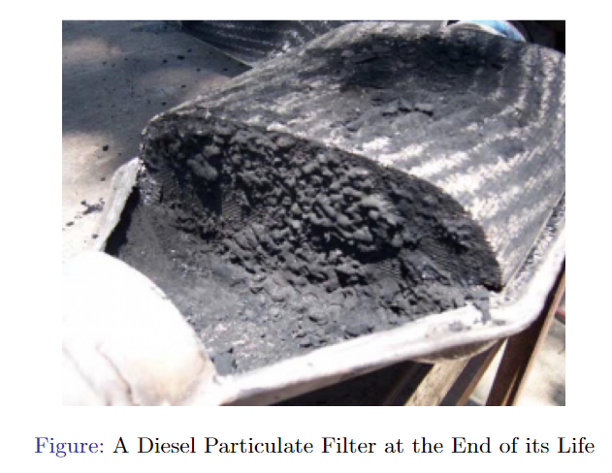
Electrification of Buses
Some benefits of electrifying school buses:
Reduced visits to hospitals and clinics for children and adults (Beatty and Shimshack, 2011).
Aerobic capacity and lung growth (Austin et al, 2019).
Student test scores.

Slide 6
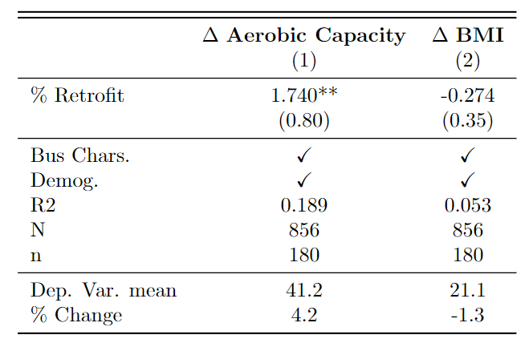
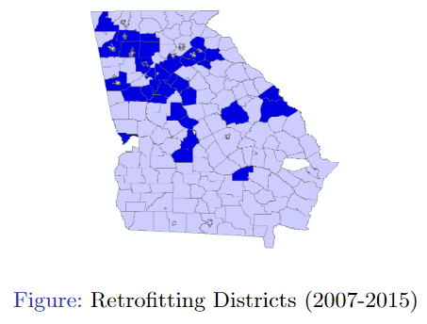
Aerobic Capacity (VO2 Max)
Natural experiment on school bus retrofits:
2,600 buses retrofitted in Georgia 2007-2015 (150,000 students).

Slide 7
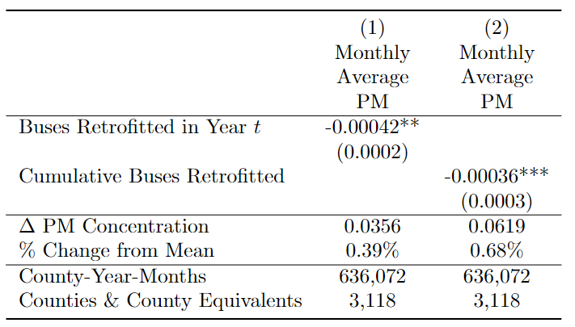
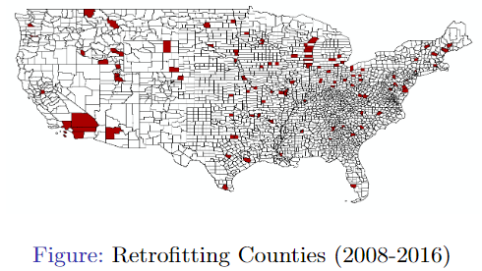
Satellite-based PM 2.5
National version:
18,000 buses retrofitted nationally 2008-2016 ($170m)

Slide 8
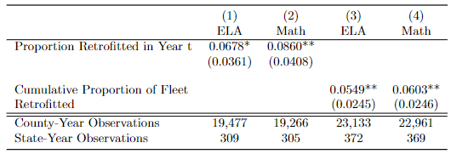
Test Scores
Also, sizeable impact on academic performance for both language arts and math test scores.
PM 2.5 benefits would have been $245m.
Test score benefits, where 1 percentile increase is $1,041 extra income after discounting implies $4.5B benefit.

Slide 9
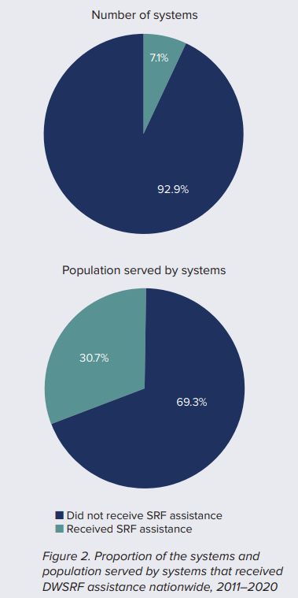
Abatement of Lead
The Drinking Water State Revolving Fund is how BIL funding will be distributed to remove lead pipes from homes, schools, daycare centers, and businesses.
States receive these funds and then distribute them to “disadvantaged” community water systems, but each state has its own definition of this term.
Small systems with more people of color are less likely to receive grants (Hansen, 2021).
Source: Hansen, 2021.

Slide 10
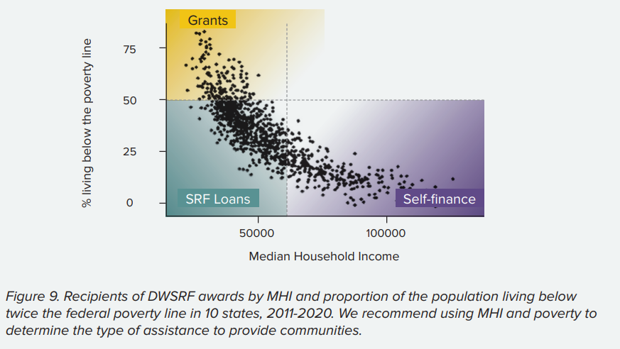
Abatement of Lead
Many states use a formulaic definition of “disadvantaged” based on being below statewide median household income.
Montana: disadvantaged if cost of water > 2.3% of the state’s MHI.
Median incomes can mask differences in poverty share.
Source: Hansen, 2021.

Slide 11
Part 2: West Virginia vs. EPA

Slide 12
Background of the Case
The 2015 Clean Power Plan would have reduced GHG emissions from existing power plants and shifted generation to cleaner sources. It gave states the authority to implement these standards and design a wide variety of programs, including allowance trading, to meet the GHG goals.
States and power companies sued EPA for over-reach, alleging that generation shifting was not a valid best technology that could be used to meet EPA’s standards.
Congress/CAA permits emission standards based on “best technologies” for regulation of new sources within the fenceline
Emissions standards and generation shifting could apply to an entire state electricity sector, hence regulating “beyond the fenceline” of the air pollution source

Slide 13
Merits of Each Side
Shortcomings in the petitioner’s argument:
Clean Power Plan never implemented, so no standing to sue EPA.
Invocation of major questions doctrine goes against judicial precedent in Chevron doctrine and Massachusetts vs. EPA.
Chevron doctrine: precedent of court deference to agency expertise where Congressional language is ambiguous.
Shortcomings in the EPA defense:
CPP and generation shifting was cost-benefit justified ($22.6b net benefits), but this fact was not used to justify the selected standard (see Cecot, 2022).
Led to criticism that CPP was not science-based and EPA would set standards “wherever the Agency sees fit.”

Slide 14
Long-Term Concerns
Many concerns with the ruling have been expressed, but a few big ones:
Precedent to invoke major questions doctrine implies significant regulations will be over-turnable by courts, including past regulations
Increased uncertainty around delegated powers weakens agency flexibility and ability to act quickly, pushes many actions back to Congress.
Prohibiting regulation “beyond the fenceline” through the CAA limits the potential range of regulatory options for GHGs.
Generation shifting often much cheaper than other GHG abatement, so weakens reduction options set for new or existing plants.

Slide 15
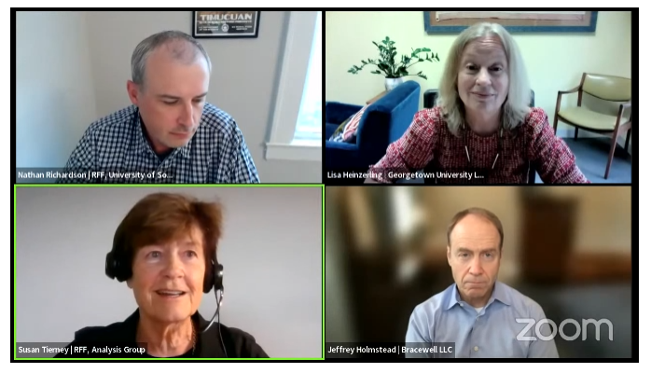
RFF Session
Two questions uncertain:
How far-reaching is the ruling?
Holmstead: narrowly affects power generation shifting.
Heinzerling: potentially affects all future agency actions not limited to climate change.
Elected congress, unelected bureaucrats, or unelected judges?
Link to RFF Event video.

Slide 16
Part 3: Inflation Reduction Act

Slide 17
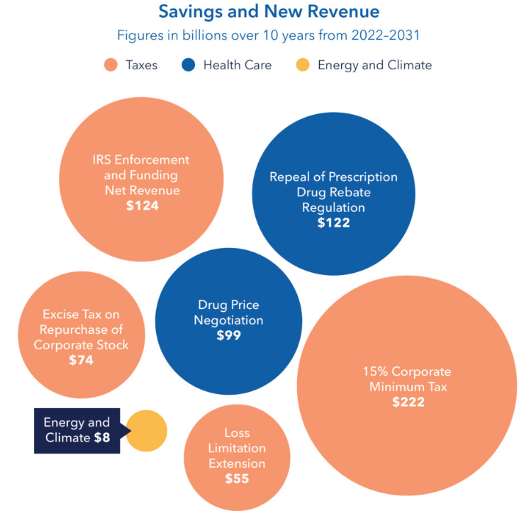
Why is it called the Inflation Reduction Act?
The IRA is a budget reconciliation bill, which makes it easier to pass because no susceptibility to filibuster and only 50(+1 VP) votes needed.
Reduces the deficit by $238 billion over a decade (CBO, 2022).
General agreement that the bill has minimal effect on inflation.
Some uncertainty if increase or decrease (CBO, 2022).
Methane fee, superfund tax.

Slide 18
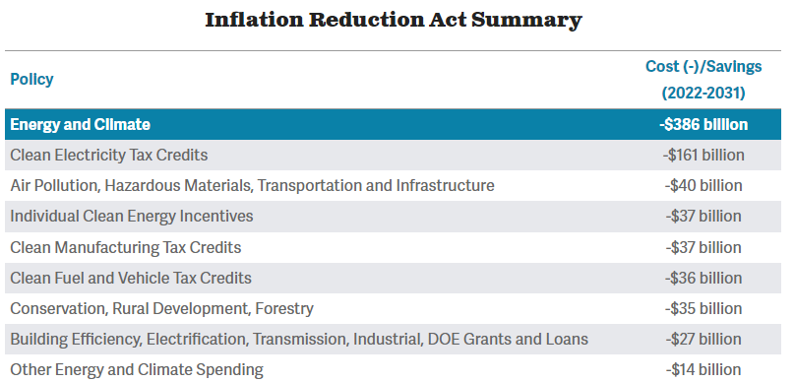
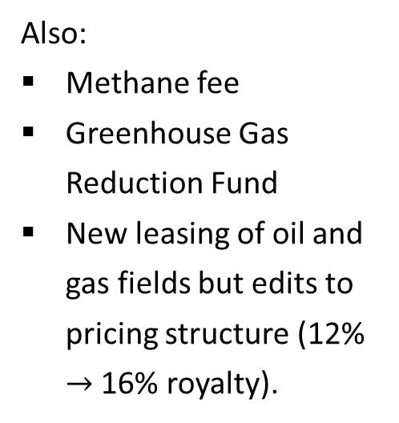
Main Provisions
Also:
Methane fee
Greenhouse Gas Reduction Fund
New leasing of oil and gas fields but edits to pricing structure (12% $→$ 16% royalty).
Figure source.

Slide 19
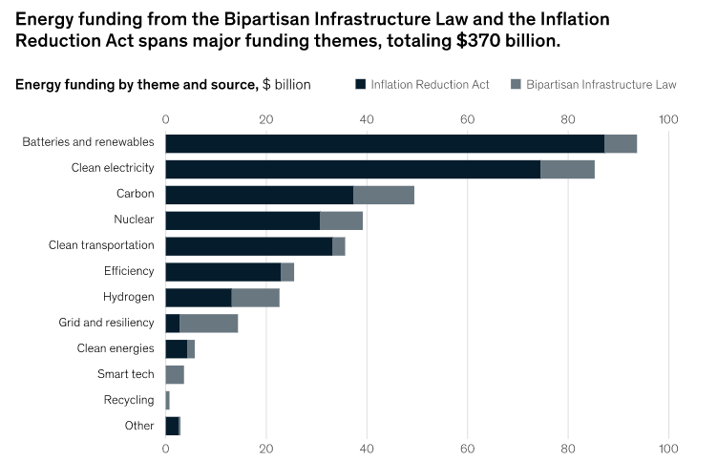
IRA vs. BIL for Climate
Source: McKinsey and Company, 2022.

Slide 20
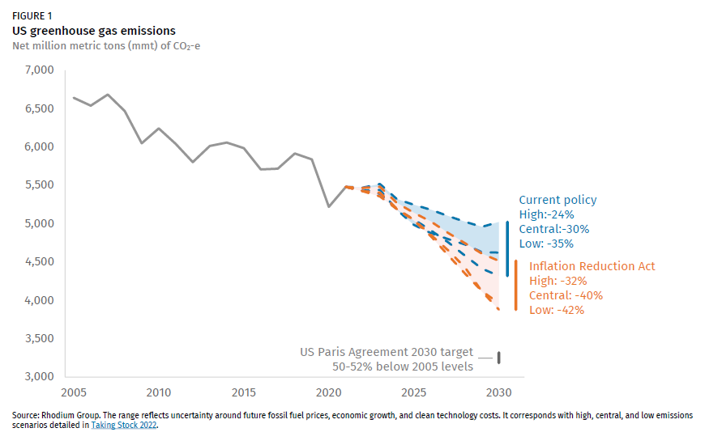
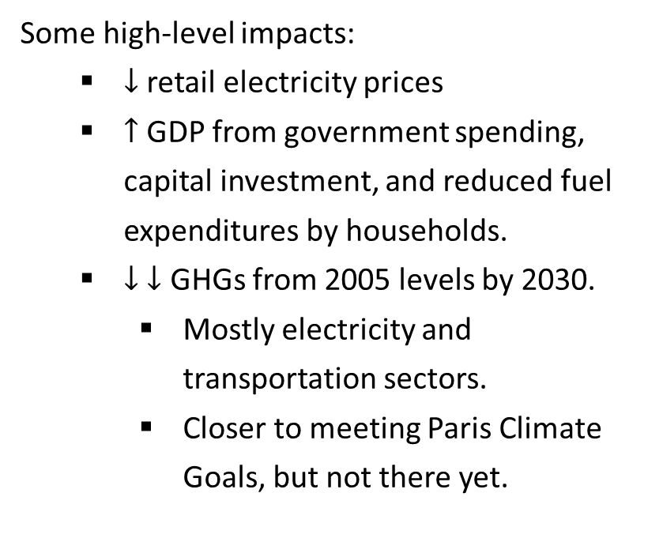
Long-term Impact?
Some high-level impacts:
$↓$retail electricity prices
$↑$ GDP from government spending, capital investment, and reduced fuel expenditures by households.
$↓$ $↓$ GHGs from 2005 levels by 2030.
Mostly electricity and transportation sectors.
Closer to meeting Paris Climate Goals, but not there yet.
Figure source.

Slide 21

Clean Energy Tax Credits
Extension of clean energy tax credits to 2025, then technology neutral renewables credits after.
Production tax credit ($5/MWh)
Investment tax credit (6% on investment)
Other major tax credits:
$85 per ton tax credit for carbon capture.
Hydrogen and nuclear tax credits.
Figure: Newest Siemens Gamesa windmills have a propeller spread of 240 meters and costs $13-20 million (Image source).

Slide 22
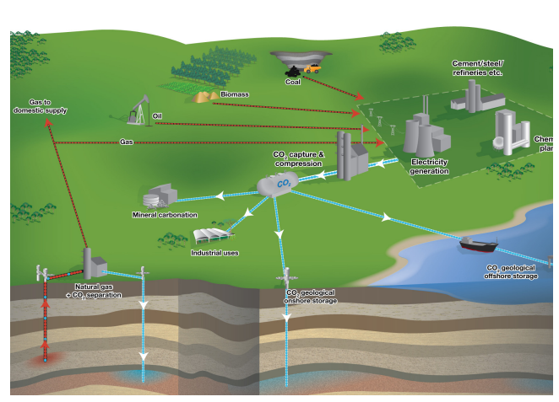
Carbon Capture and Sequestration
CCS dramatically lowers GHGs emissions overall, but also increases burning of fossil fuels to power CCS tech itself and continues operation. Mixed effects:
Some GHGs from transporting additional fossil fuels unless clean transport
More PM, NOx
Threefold increase in local ammonia due to solvents that capture CO2.
Source: European Environment Agency, 2011

Slide 23
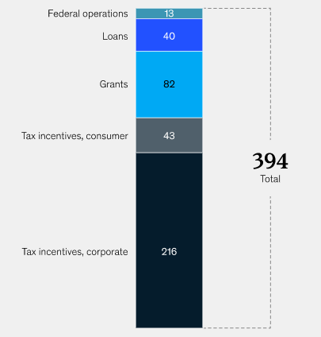
Consumer Tax Credits
Roughly $43 billion in tax credits directly to consumers:
Heat pumps and electric water heaters (capped at $2000)
Rooftop solar (up to 30% of cost, capped at $1200 total)
Electric vehicles ($7500 for new and $4000 for used EVs)
Source: McKinsey and Company, 2022.

Slide 24
Who Benefits from Clean Energy Tax Credits?
Consumer tax credits benefit wealthiest income quintiles (Borenstein and Davis, 2016).
Using tax return data on home weatherization, hybrid/electric vehicles and solar panel credits:
Top quintile received 60% of benefits, bottom three 10%.
Top quintile received 90% of all credits for electric vehicles.

Slide 25
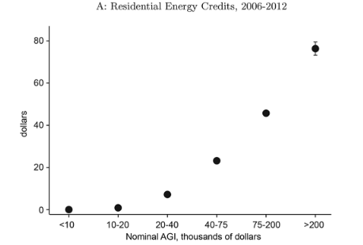
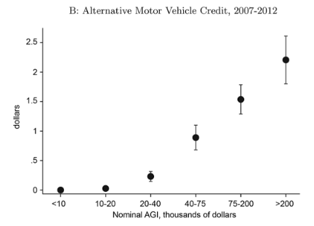
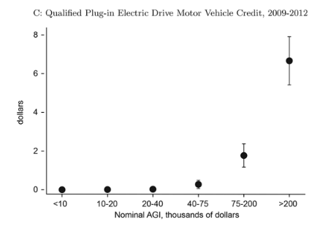
Who Benefits from Clean Energy Tax Credits?

Slide 26
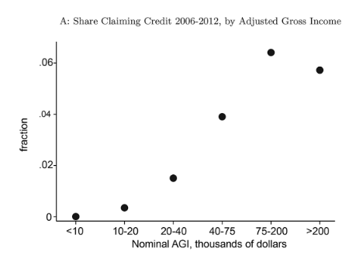
Who Benefits from Clean Energy Tax Credits?
Tax credits benefit wealthiest income quintiles (Borenstein and Davis, 2016).
Explanation of findings:
Renters not eligible
Share of tax filers claiming credits
Larger amounts for highest incomes

Slide 27
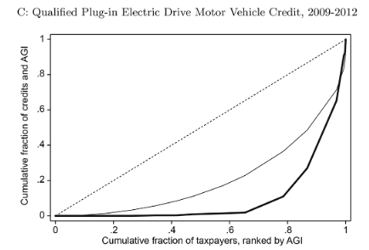

Concentration Curve for EVs

Slide 28
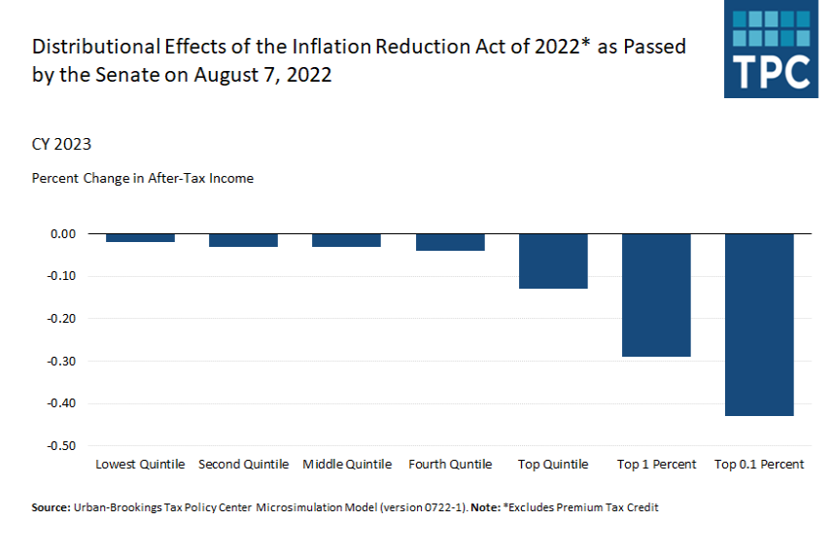
Who Pays?
Link.

Slide 29
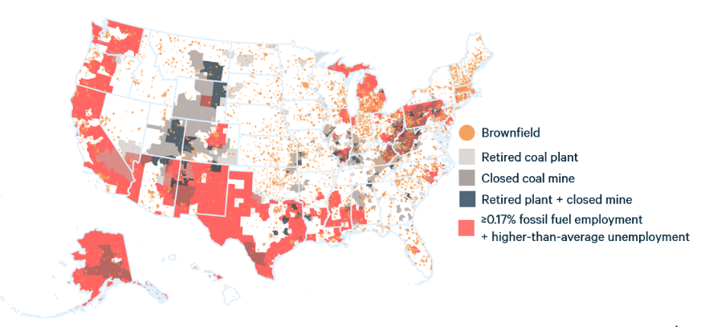
Energy Communities
Special consideration given to “energy communities.”
Bonus tax credits ($0.50) for electricity production
Bonus tax credits 6 – 16% on investments in electricity production
Increased political support, notions of fairness, and also extent of subsidy.

Slide 30
Greenhouse Gas Reduction Fund
The IRA created a new Greenhouse Gas Reduction Fund ($27B) to provide competitive grants for clean energy and climate-related projects that reduce GHGs.
$7b for distributed zero-emission electricity production to low-income communities such as solar rooftop grants
$20b in financial assistance in competitive grants for projects that reduce GHGs ($8b specifically for low-income communities).
Comments on the fund are open to the public but will close on December 5th, 2022.
Only 15 comments so far.

Slide 31
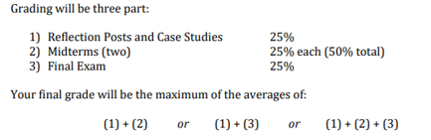
Next class
Wednesday’s class will review Modules 1 and 2. Professor Parthum will also discuss recent developments with the social cost of greenhouse gases.
Please complete your final case study by December 5th.
Last note: the final is not mandatory if you are happy with your current grade.

